Slide 1
AI Recruiter
Team Patronus
Team Members: Chaithra Bhat
Avani Pathak
Sejal Arora

Slide 2
Description
52% of talent acquisition leaders say that the most difficult part of their job is to shortlist the right candidate and 3% of candidates never hear back from a company after one touchpoint. On the flip side, it’s a challenge for employers to communicate well with all their candidates. For high volume recruiting, this would require communicating with thousands of candidates, in addition to a recruiter’s normal screening functions and other duties.
Artificial Intelligence enabled software bots can definitely provide a solution for this problem.
As Siri and Alexa are becoming more common, candidates are welcoming the opportunity to interact with a chatbot. Today’s candidates, especially now after the Covid 19 pandemic has struck the entire world, are aware that the recruiting process might not be human-to-human at every touchpoint, but value the chance to receive information in whatever way they can. Through facts it has been pointed out that the ideal recruiting interaction is a mix between innovative technology and personal human touch.

Slide 3
Our Idea
A recruitment chatbot, or “conversational agent”, is a software application that uses Artificial Intelligence technology and is designed to mimic human conversational abilities, in the sense that it’s programmed to understand written and spoken language and respond correctly, during the recruiting process.
The chatbot can help recruiters with administrative tasks such as:
Collect information from candidates such as their resume and contact information.
Ask screening questions about candidates’ experience, knowledge, and skills.
Judge the candidate’s personality by asking situational questions.
Rank candidates on metrics such as qualifications, engagement, or recent activity.
Answer FAQs about the job and the application process.
Schedule an interview with a human recruiter.
Thus through this AI recruiter chatbot, we can automate the time consuming recruitment tasks and optimize the hiring process.

Slide 4
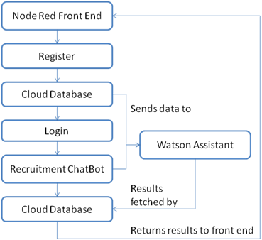

Slide 5
Benefits of an AI Recruiter
Automation: We are eliminating the time consuming and lengthy manual recruitment process that happens before an interview of a candidate by automating the talent acquisition process through the AI recruitment chatbot.
Filtration based on various criteria : Based on the skills that a candidate satisfies, he/she will then be further promoted to an interview for a designation that will ensure the effective role of the candidate. Recommendations will also be provided to a candidate based on skill sets he/she owns.
Efficient: Over time, the AI component of the chatbot will begin to understand which metrics it should be looking for based on the data it collects and rank candidates accordingly which will increase the efficiency of the chatbot.
Effective: Since the chatbot considers every aspect of each candidate, considers all the data to make quicker decisions, keeps in touch with the candidates thereby improving their experience, lowers marketing costs and thus increasing retention.
Secure: The data is secure since we will be using the IBM Cloud which is housed in nondescript facilities and the physical access is strictly controlled both at the perimeter and at building ingress points by professional security staff.

Slide 6
Future Scope
To integrate Smart Document Analyzer along with our chatbot to improve the scanning of resumes uploaded by the candidates.
To improve the model by providing it with different types of inputs and hence make it more efficient and effective.

Slide 7
Conclusion
Thus through this AI recruiter chatbot, we can automate the time consuming recruitment tasks and optimize the hiring process. A recruitment chatbot, or “conversational agent”, is a software application that uses Artificial Intelligence technology and is designed to mimic human conversational abilities, in the sense that it’s programmed to understand written and spoken language and respond correctly, during the recruiting process. The chatbot can help recruiters with various administrative tasks. There is improved candidate experience and recruiter experience through timely communication, easy to use chatbot interface, display of various analyses and integration of all data at one platform.

